Slide 1
John B. Wright Title I Program Home of the Wildcats
Annual Title I Parent Meeting 8/31/2022

Slide 2
John B. Wrigh
Has been allocated
$342,420
in Federal Title I dollars for
School Year 2022-2023

Slide 3
The purpose of Title I is to ensure that all students …
…receive a high-quality education
…from appropriately certified, well-trained staff
…who use evidence-based instructional methods

Slide 4
Title I Funds are for…
supporting struggling learners with additional resources and help in reading and mathematics.

Slide 5
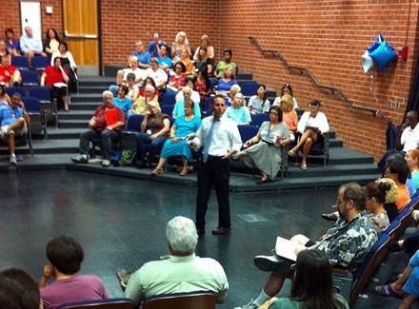
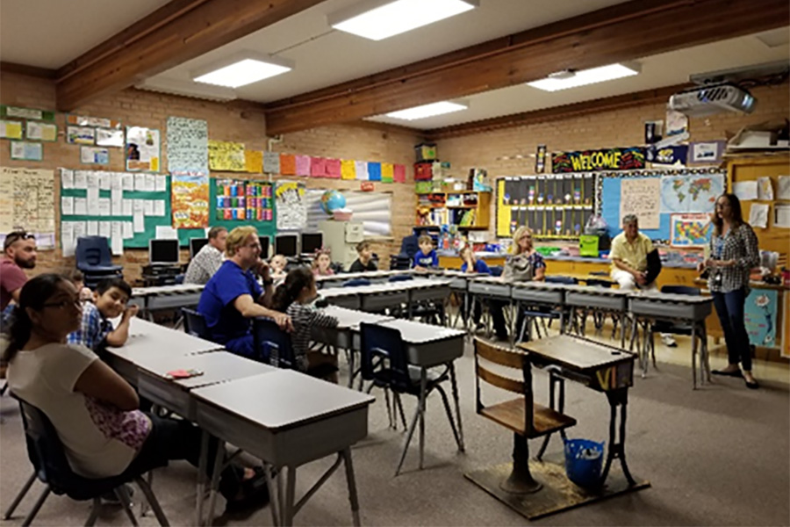
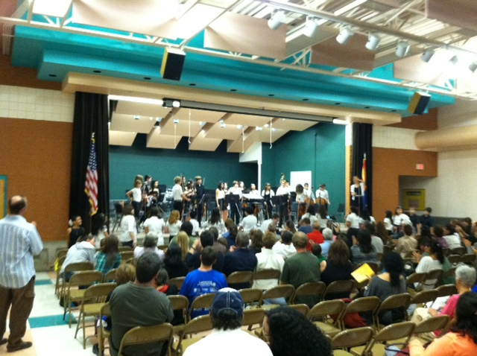
Title I funds help our school offer families
interactive learning opportunities
to
support student achievement at high academic levels

Slide 6
Arizona’s Academic Standards Assessment (AASA)
ELA-Reading | Math
3rd – 18% | 3rd – 29%
4th – 19% | 4th – 11%
5th – 31 % | 5th – 31%
2022 Letter Grade - (Pending) 2019 Letter Grade – “B”

Slide 7
School Letter Grade
The Arizona Department of Education (ADE) assigns each school a letter grade based on spring 2022 Arizona’s Academic Standards Assessment results. When the information is received, we will notify our community.
School grades are based on:
The percentage of students who passed the Arizona’s Academic Standards Assessment (AASA) exam.
The percentage of students who attained academic growth reaching or exceeding grade level expectations.
Additional factors such as the percentage of students evaluated, graduation rate-High School Only, reclassification of English language students.
Title I funds help our school maintain / improve our school score by improving student achievement through the strategic use of federal funds.

Slide 8
Integrated Action Plan (IAP)
Our school leadership team composed of staff and families completed a needs assessment in the spring. We address student needs and allocate Title I resources to support:
Well trained staff using effective teaching practices
To provide intervention for struggling students
Families to help students achieve in school

Slide 9
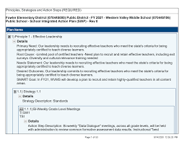
Integrated Action Plan (IAP)
To ensure that all students receive a high-quality education we employ appropriately certified staff, who use research based instructional methods. Our school plan includes the following:
60 Minutes of regular reading instruction per day.
60 minutes of regular mathematics instruction per day
Teacher Training
Curriculum Service Providers to support teachers with instruction, assessments, and data.

Slide 10
Integrated Action Plan (IAP)
To support struggling learners with additional resources and help in reading and mathematics, our school plan to improve reading achievement includes the following:
Reading/Math Interventions
60 minutes per day
Additional Reading/Math Classes
2 Tutors – K-2nd Grade
2 Tutors – 3rd – 5th Grade
30 minutes, 3 times/week
Reading/Math Tutors
Tutoring will begin in October
Other action steps (list here)

Slide 11
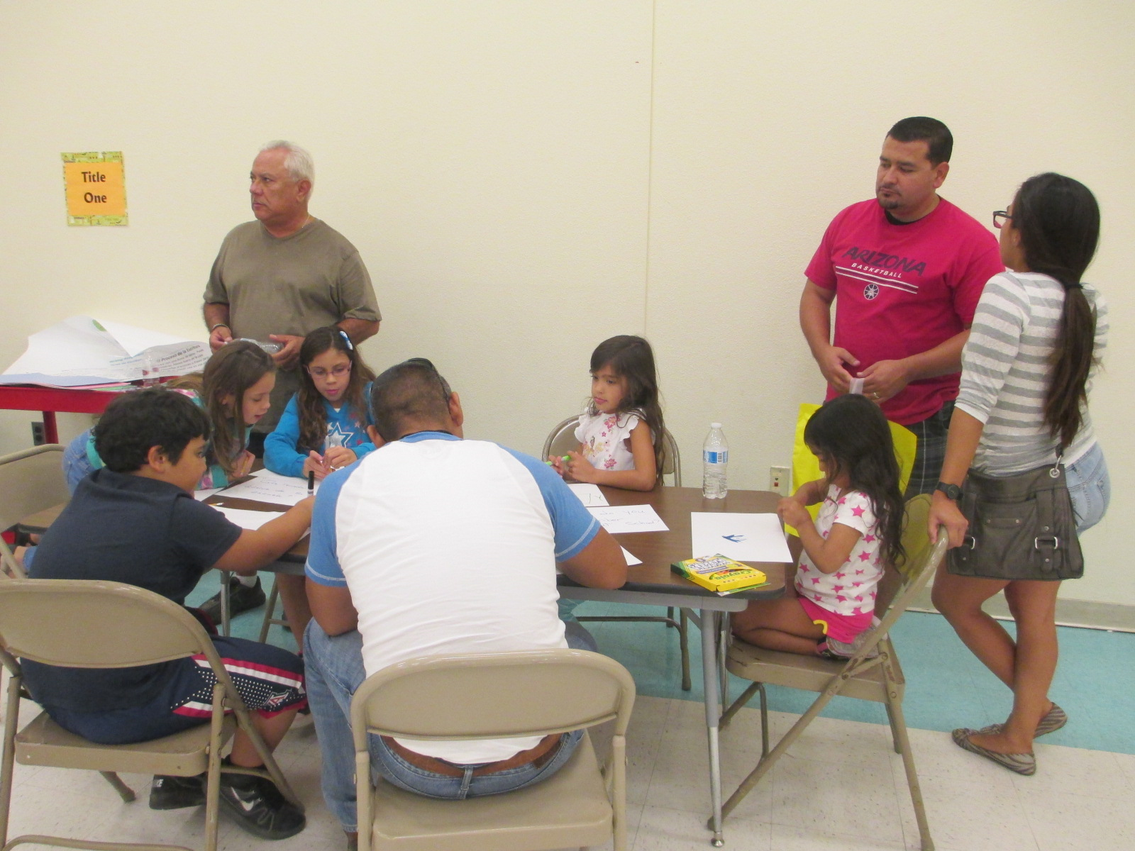
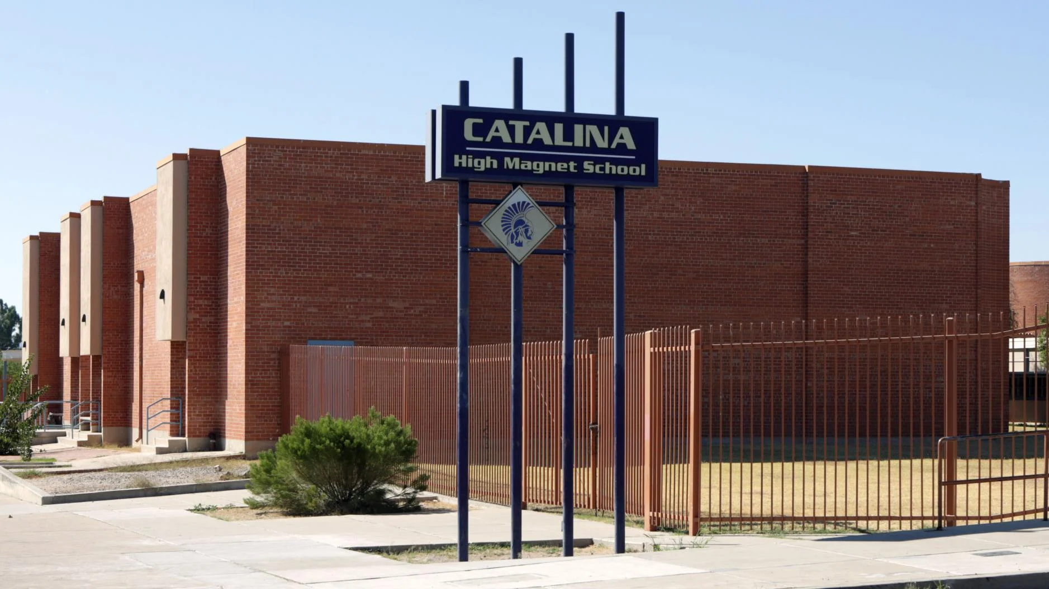
School Integrated Action Plan (IAP)
Academic Family Engagement
Our plan includes steps to promote academic family engagement:
District Parent Involvement Policy
School Parent Involvement Policy
Title I Parent Compact
TUSD Family Centers
How will parents know what services are available (newsletter, website, marquees,etc.; all of the above?)

Slide 12
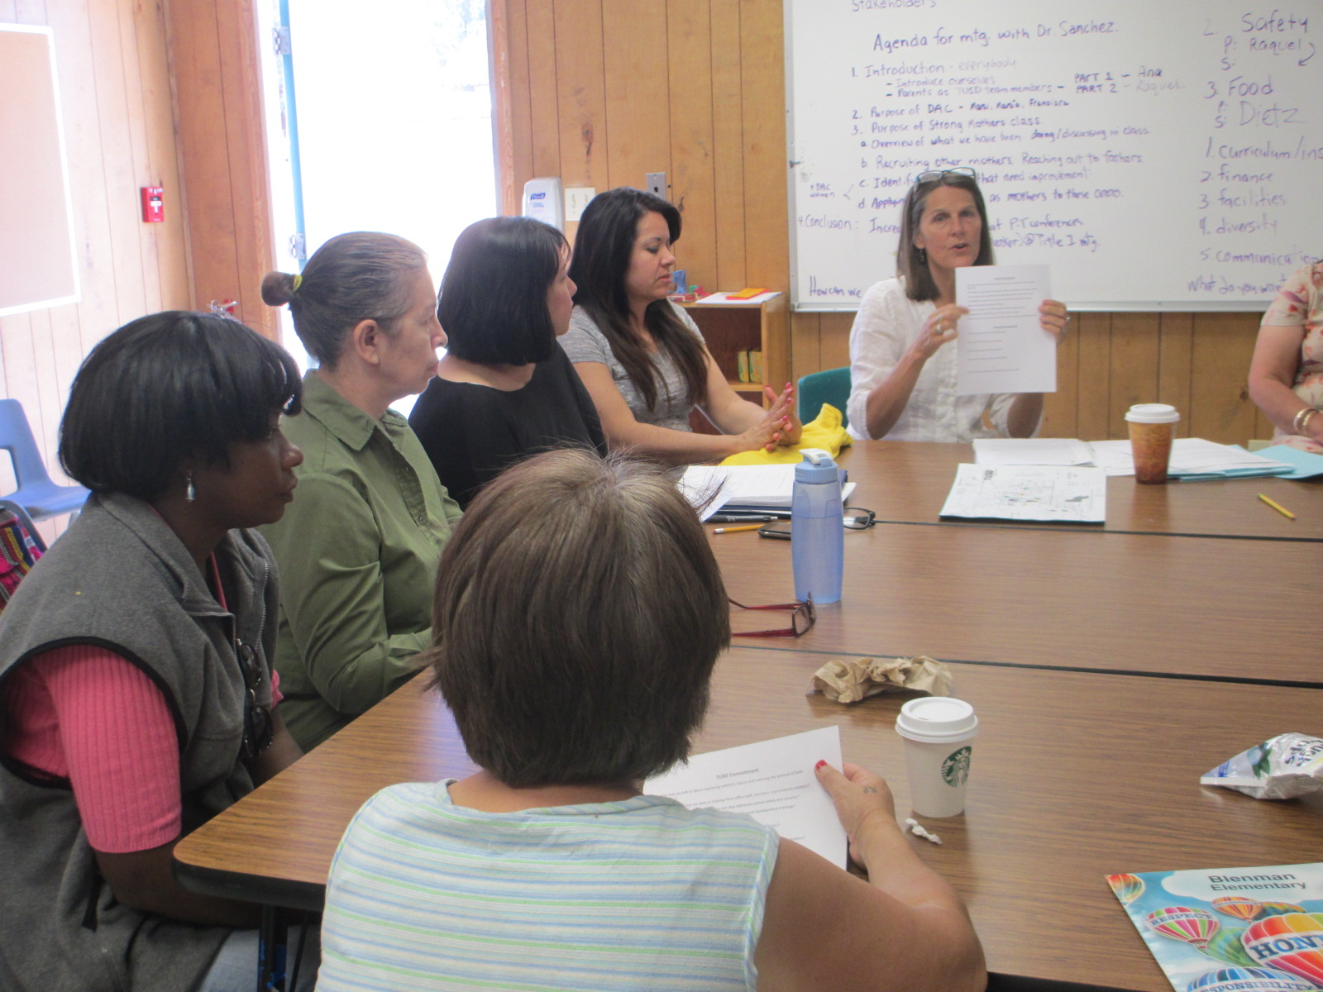
Parents Right to Know
You have the right to request:
The qualifications of your child’s teacher and instructional staff
Your child’s level of achievement based on required state assessments
You must be informed within 4 weeks if:
Your child is being taught by a teacher who does not meet the appropriately certified requirements of the state
All of this information must be in a language and format that is understandable to you.

Slide 13
Important Dates to Remember
Parent Teacher Conference
Sept. 14-16
Feb. 9-10
Student Report Cards
Oct. 7
Dec. 23
Mar. 17
May 26

Slide 14
Coming up:
Grandparents Day – Friday, Sep. 9
Trunk or Treat – October
Fall Festival - November

Slide 15
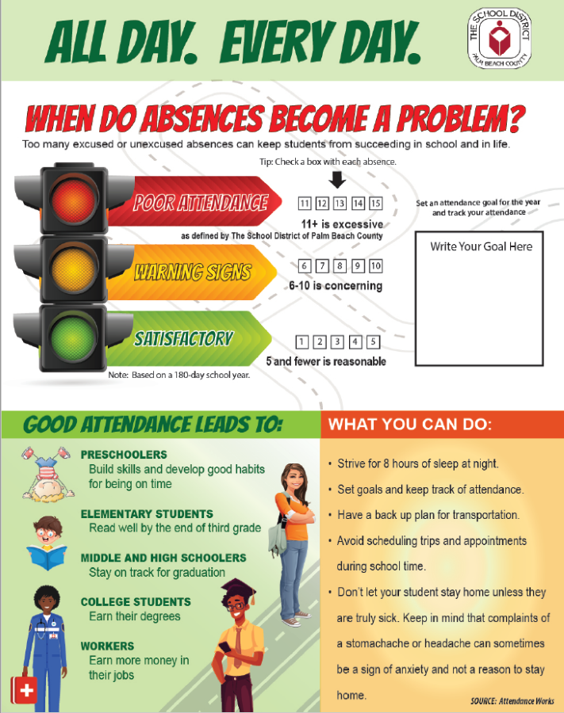

Slide 16
Thank you!
For more information or to access the school Integrated Action Plan Contact:
Brenda Encinas, Principal brenda.encinas@tusd1.org 520-232-8100

